Slide 1
CS 176 Final Project: Cancer, Covid, and Demographics
Prisha Marpu - pmarpu@purdue.edu
Rohan Baste-Bania - rbasteba@purdue.edu
Rishi Jain - jain855@purdue.edu
Rinta Kubo - rkubo@purdue.edu

Slide 2
Introduction - Our Goal and Methodology
Goal: Find any relationships between COVID-19 outcomes, demographic groups, and cancer-mortality rates down to county-level. To do this, we need to create a unified data frame source containing data on total COVID deaths and cases, demographic profiles, and cancer deaths for each county and state.
Questions:
Do counties with higher cancer mortality rates have higher COVID death rates?
Do demographic groups experience different COVID outcomes? If so, what groups are the most vulnerable to COVID?
1. Finding Data
2. Loading & Merging Data
3. Data Wrangling
4. Exploratory Data Analysis
For each county, we need…
1
Clean Data
Visualize
Load all datasets
1
Demographic Info
2
Filter
2
Merge all datasets
3
Sort
Pivot
Cancer Mortality Rate
Time-series of COVID Related Info
4
Aggregate
3
One unified, consolidated table
Identify Associations
5
Augment

Slide 3
Data Explanation
Our first dataset gave general demographics data for each county in the US
  Shows population distribution across sex and race, showing total male, female, white, black, and hispanic population
The second dataset shows Covid-19 data across counties in the US for dates spanning from 1/20/2020 to 12/04/2020
  For each day, it shows the number of cases and deaths cumulative since the beginning of Covid
The third dataset we chose shows cancer death rates per county in the US
  Shows cancer rates over the five year range of 2019-2023
  The data is estimated and gives a confidence interval as well as a mean
All datasets have a FIPS code, which is a unique identifier for each county, which we used for data merging

Slide 4
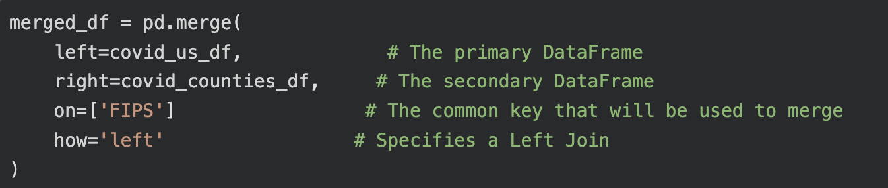
Data Merging
- For data merging, we link the time-series COVID-19 data with the static demographic data.
- the FIPs code is a common key, which will be used to create a single, unified Data Frame that is ready for analysis.
- Two data frames were merged using the FIPS column that appears in both datasets.
- a left join is performed, meaning all rows from the first data frame (covid_us_df) are kept, and then all the matching rows from the second data frame (covid_counties_df), are added if they are available
- Final combined dataset is stored in merged_df

Slide 5
Data Cleaning
Removed unnecessary/irrelevant columns, grouped data by columns, and augmented missing data.
Tried to to minimize the size of our dataset while retaining all of the necessary information before beginning our analysis phase
Checked for duplicates
print("Number of duplicated rows:",merged_df.duplicated().sum())
Replace invalid data entries with NaN ('*' and '')
columns_to_replace = ['Upper 95% CI for Death Rate', 'Avg Deaths per Year (Cancer)']
merged_df[columns_to_replace] = merged_df[columns_to_replace].replace({'*': np.nan, '': np.nan})
merged_df
Convert 'Date' column to datetime format
# Convert 'Date' column to datetime format
merged_df['Date'] = pd.to_datetime(merged_df['Date'], format="%Y-%m-%d")
print("'Date' Column Type:", merged_df['Date'].dtype)
Notes:
Prisha

Slide 6
Data Sorting
Data sorting is used to help extract cumulative COVID case and death totals for each county during data aggregation. This also allows for time series analysis to be possible for any county and state.
Sorting filtered_df by County -> Date using sort_values():
Returns a Dataframe where each county is displayed in chronological order
inplace=True modifies the data frame without creating a copy
filtered_df.sort_values(by=[‘FIPS’, ‘Date’], inplace=True)
FIPS | Date | County
18157 | 2020-03-25 | Tippecanoe County
53061 | 2020-03-25 | Snohomish County
18157 | 2020-03-26 | Tippecanoe County
53061 | 2020-03-26 | Snohomish County
FIPS | Date | County
18157 | 2020-03-25 | Tippecanoe County
18157 | 2020-03-26 | Tippecanoe County
53061 | 2020-03-25 | Snohomish County
53061 | 2020-03-26 | Snohomish County
sort_values()
Groups data by the county’s FIPS code, then by date.

Slide 7
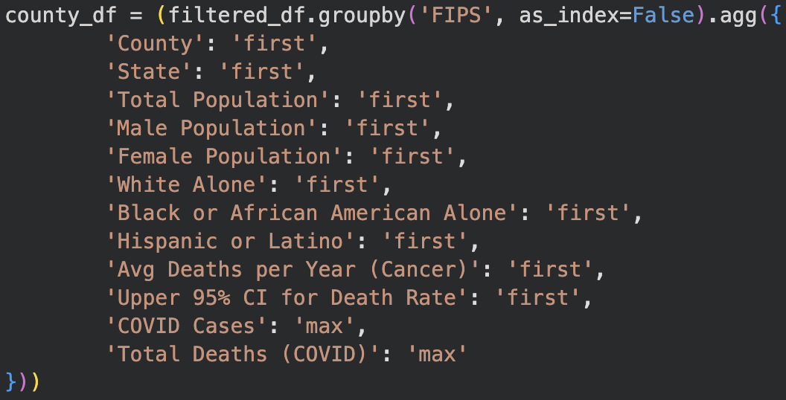
Data Filtering and Data Aggregation
We used data filtering to only focus on specific time frames, specific columns, and specific rows
This was used to create modified data frames to assist in our visualizations
Filtered data to only include dates from 1/20/2020 - 12/04/2020
2. Created new dataframe to only include final rows of time series data

Slide 8
Data Augmentation
High COVID and cancer cases and deaths naturally scale with population size. Augmenting data is necessary to avoid bias during analysis.
Standardization Formulas:
Cases/Deaths Per 100K = (County Count / Total County Population) x 100,000
Population Percentage = (Total Demographic Count / Total County Population) x 100
Case Fatality Rate = (Total COVID Deaths / Total COVID Cases) x 100
county_df['COVID Cases per 100K'] = (county_df['COVID Cases'] / county_df['Total Population']) * 100000
county_df['COVID Deaths per 100K'] = (county_df['Total Deaths (COVID)'] / county_df['Total Population']) * 100000
county_df['Cancer Deaths per 100K'] = (county_df['Avg Deaths per Year (Cancer)'] / county_df['Total Population']) * 100000
county_df['Male Pct (%)'] = (county_df['Male Population'] / county_df['Total Population']) * 100
county_df['Female Pct (%)'] = (county_df['Female Population'] / county_df['Total Population']) * 100
county_df['White Pct (%)'] = (county_df['White Alone'] / county_df['Total Population']) * 100
county_df['Black Pct (%)'] = (county_df['Black or African American Alone'] / county_df['Total Population']) * 100
county_df['Hispanic/Latino Pct (%)'] = (county_df['Hispanic or Latino'] / county_df['Total Population']) * 100
county_df['COVID Death Rate'] = (county_df['Total Deaths (COVID)'] / county_df['COVID Cases']) * 100
Standardized Case and Death Rates
Demographic Group Percentages
Case Fatality Rate

Slide 9
Dataframes Used for Our Analysis
Demographics Dataset
Load (read_csv),, capitalize all columns,
Merge Data
merge()
COVID Dataset
Cancer Dataset
Sort Data
sort_values()
Clean Data
drop()
replace({‘*’: np.nan})
Augment Data
Aggregate Data
groupby()
filtered_df (for time-series analysis)
county_df
state_df

Slide 10
Data Visualizations

Slide 11
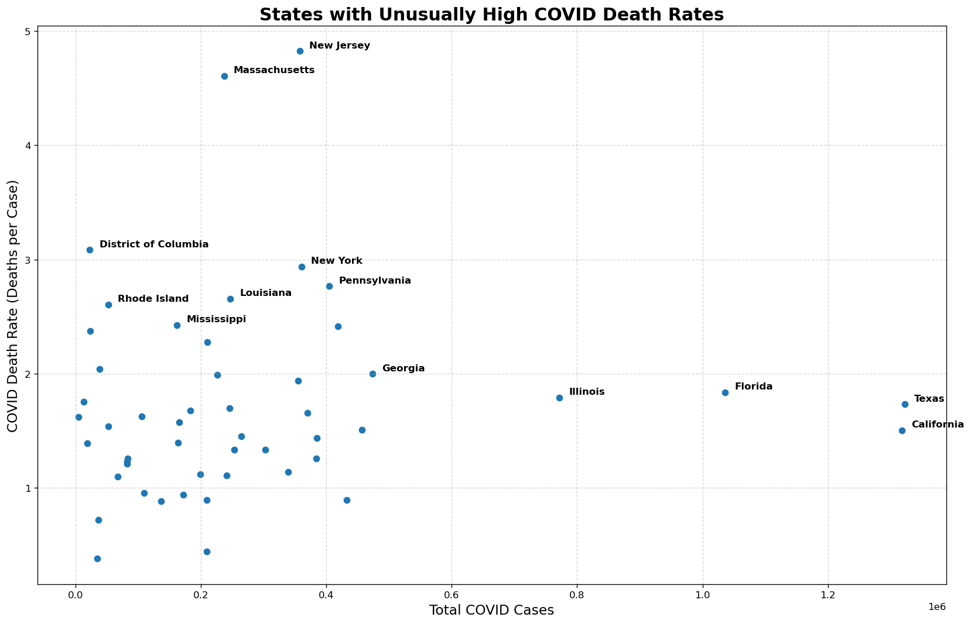
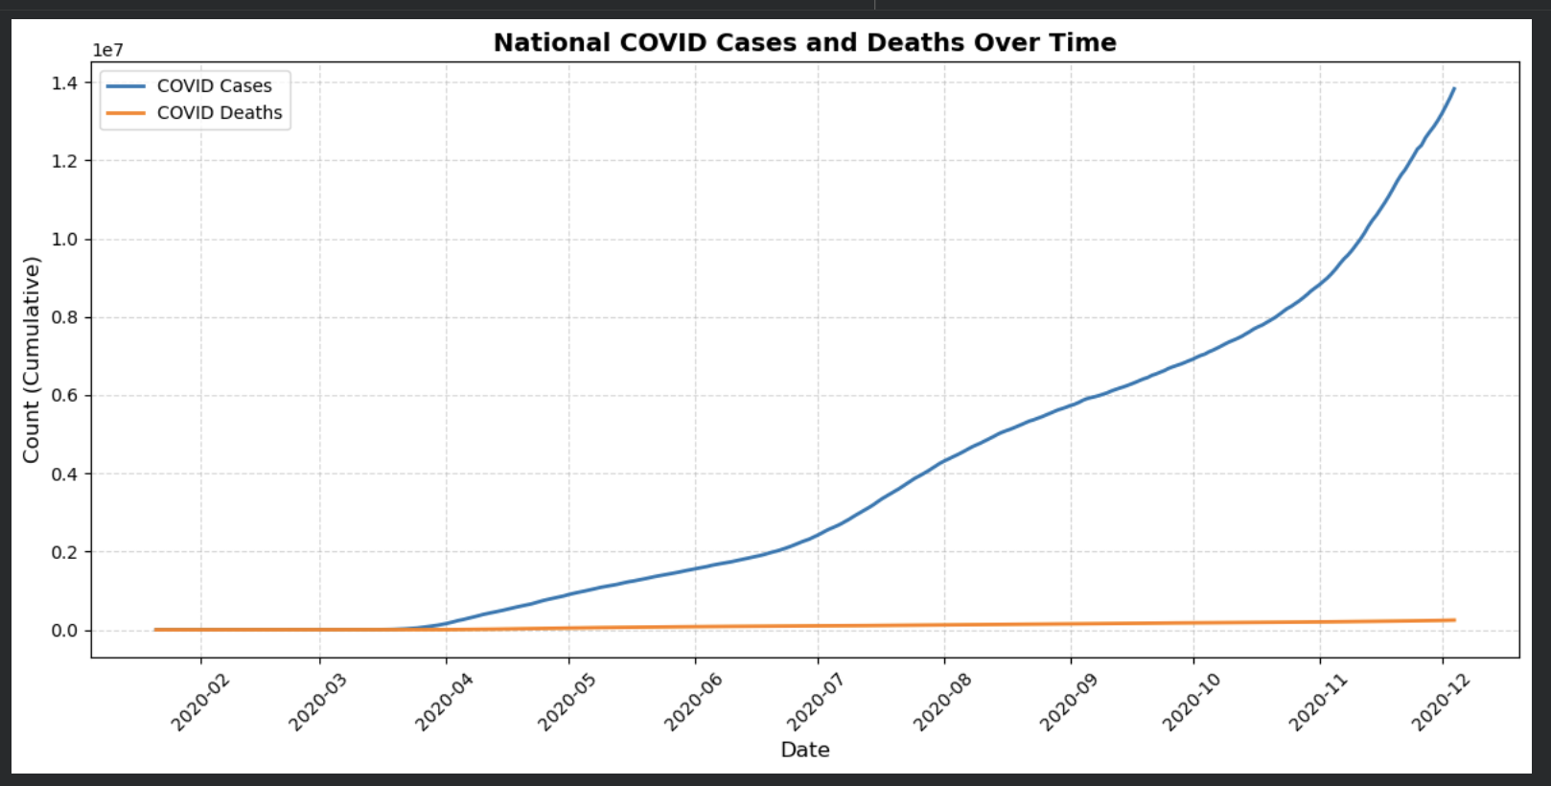
National COVID Cases and Deaths Overtime
U.S. cases rise sharply through 2020, especially mid-year onward.
Deaths increase steadily but remain far below case levels.
Growing gap between cases and deaths suggests improved testing and treatment
A few states (mainly New Jersey, New York, Massachusetts, and Connecticut ) have a noticeably higher death-per-case ratios.
Bigger states like California, Texas, and Florida had a lot of cases but much lower fatality ratios, showing that having more cases doesn’t correlate automatically to more severe outcomes.
Notes:
Prisha

Slide 12
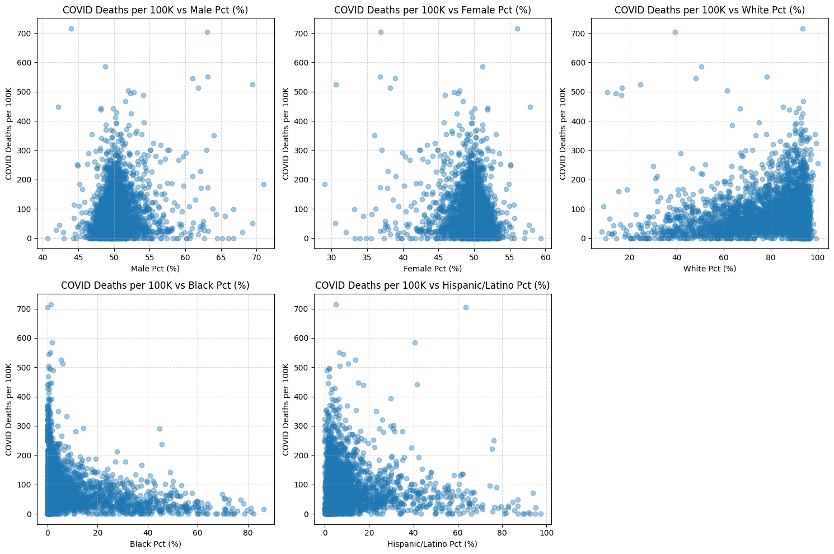
COVID Mortality Rate vs. Demographics
These series of graphs show the relationship between Covid deaths per 100K people vs percentages of sex and race
Correlations are decently low, but there are some trends
When counties have more or less than an even male-female split, death rates decrease
Higher white percentage counties have higher death rates, whereas higher black and latino counties have a lower rate

Slide 13
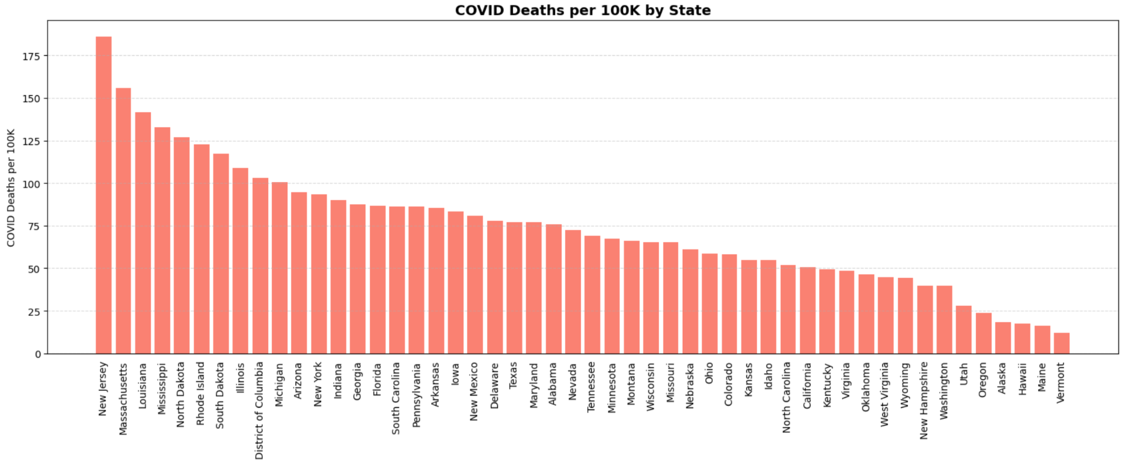
Covid Deaths per 100k by State
- From New Jersey to Vermont, Covid Deaths per 100k gradually decreased
- Starting at around 180k at New Jersey going all the way around 15k at Vermont, showing the decrease of Covid Mortality by state.

Slide 14
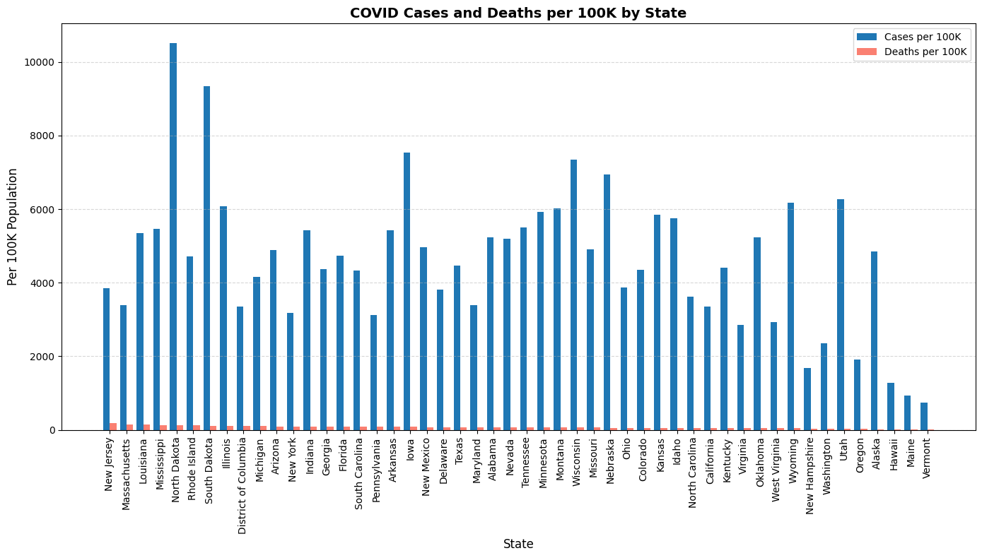
COVID Cases and Deaths per 100k by State
- This bar graph shows the correlation between Covid Cases and Deaths per 100k by State
- Overall, this shows that no matter how many cases there are for each state, it doesn’t necessarily always mean there will be more deaths if there are more cases reported.
- Conclusion: Covid Cases and Covid Deaths have little to no correlation to each other

Slide 15
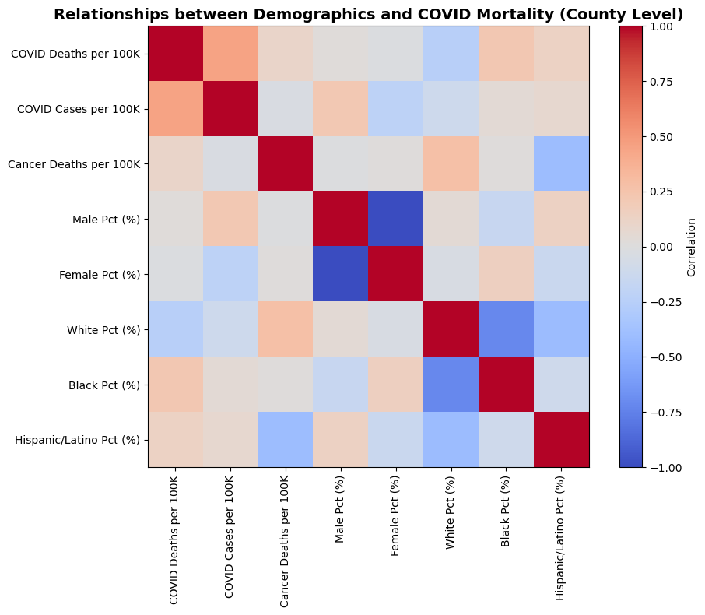





Relationships between Demographics and COVID
Positive r: Variables increase together
r = ~0: Their association does not predict each other’s outcome
Negative r: As one variable increases, another decreases
Higher Cancer Mortality
Higher
COVID Deaths
Higher MALE POPULATION
Higher COVID Deaths
Gender
COVID Outcomes Unchanged
Higher BLACK AND HISPANIC POPULATION
HIGHER COVID DEATHS
Strategic
budgeting
Strategic
budgeting
Strategic
budgeting
Strategic
budgeting
Decrease avg time-to-hire by 20%. Achieve 50% participation in leadership program.
Decrease avg time-to-hire by 20%. Achieve 50% participation in leadership program.
Decrease avg time-to-hire by 20%. Achieve 50% participation in leadership program.
Decrease avg time-to-hire by 20%. Achieve 50% participation in leadership program.
XX
XX
XX
XX
R² Value between COVID Deaths per 100K and DEMOGRAPHIC PROFILES:
Hispanic Pct (%): 0.048
Black Pct (%): 0.016
Notes:
Correlation Heatmap: color-coded correlation matrix for standardized variables
Helps identify any potential drivers to COVID-19 outcomes
The darker the color, the stronger the relationship between two variables
Blue (-1) means negative relationship, red (1) means positive relationship
Correlation Coefficient r between 'Black Pct (%)' and 'COVID Deaths per 100K': 0.22
Coefficient of Determination R^2 between 'Black Pct (%)' and 'COVID Deaths per 100K': 0.048
Correlation Coefficient r between 'Hispanic/Latino Pct (%)' and 'COVID Deaths per 100K': 0.125
Coefficient of Determination R^2 between 'Hispanic/Latino Pct (%)' and 'COVID Deaths per 100K': 0.016

Slide 16
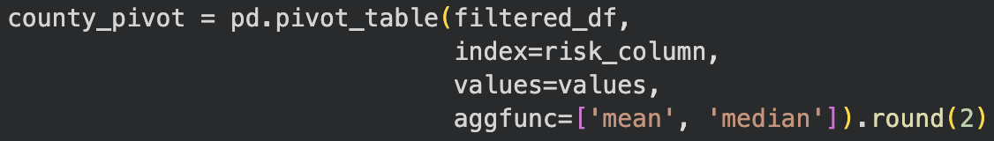
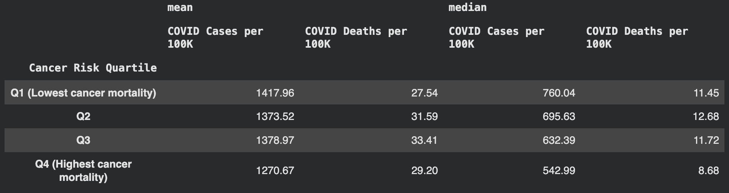
Data Pivoting
We used data pivoting to show different statistics across multiple columns
Our use of pivoting helped us create the graph on the last slide
We used a pivot table to find the mean and median for Covid cases and deaths per 100k across the cancer quartiles

Slide 17
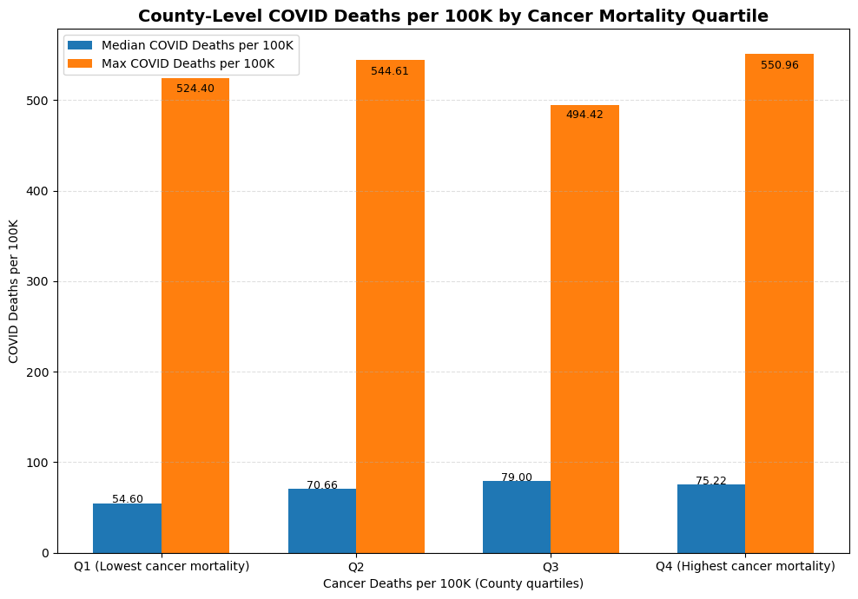
COVID Mortality Rate by Cancer Mortality Quartiles
The chart groups U.S. counties into four quartiles based on their cancer death rates, from lowest (Q1) to highest (Q4).
For each quartile, it displays:
  Median COVID deaths per 100,000 (blue bars)
  Maximum COVID deaths per 100,000 (orange bars)
This shows how COVID mortality changes depending on how healthy or unhealthy a county already is
COVID death rates rise as cancer mortality rises.
  Q1 (lowest cancer mortality): 54.6 median COVID deaths per 100K
  Q4 (highest cancer mortality): 75.2 median COVID deaths per 100K
  This trend suggests that counties with worse underlying health were more vulnerable during COVID.
Counties with high cancer mortality also saw some of the highest COVID death spikes.
Notes:
Prisha

Slide 18
Data Citation
Demographics Data: Demographics: Population, Race, Gender Data County | Kaggle
Covid Data: COVID-19 in USA
Cancer Data: County Cancer Death Rates

